Slide 1
Skill 1: Table Structure Recognition (TSR)
DOCUMENT AI 알고리즘팀
2026. 01. 21

Slide 2
Goal
Prototype Agent Skills - TSR
Agent: Autonomous, minimizing human intervention
Skills: Task specific modular
TSR (Task): Table Structure Recognition
Prototype: Simple, end-to-end functional, modular & extensible

Slide 3
Content
Introduction
Proposed System
Implementation
Demo
Test & Results
Conclusion

Slide 4
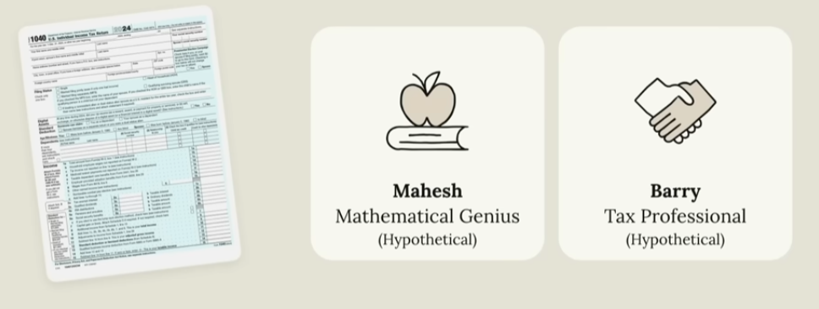
Introduction
Claude Agent Skill
What is Agent Skills?
Task specific modular
Agent activates only when needed
Examples: TSR, table detection, doc classification,
Dev simplified: “Folder”
Why we need Agent Skills?
Domain/Task expertise
Modular & Extensible
Agent Skills
📁 skills/
├── 📁 skill_1/
├── 📁 skill_2/
├── 📁 skill_3
├── 📁 skill_3
└── 📁 ...
Skill Anatomy
📁 skill-name/
├── 🗎 SKILL.md
├── 📁 scripts/
├── 📁 references/
└── 📁 assets/

Slide 5
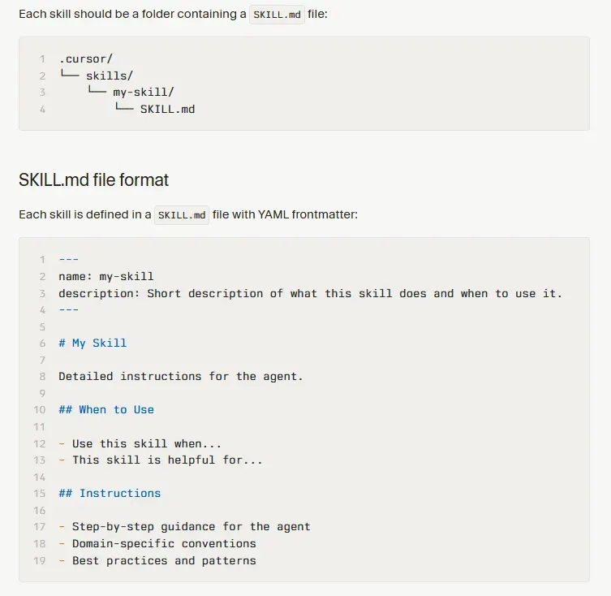
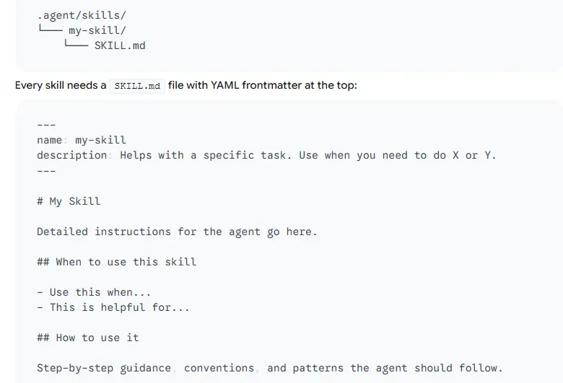
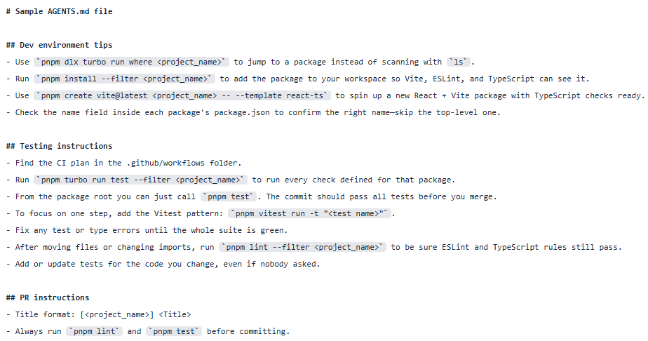
Introduction
Available Agent Skills
Claude - Agent Skills
Google Antigravity – Agent Skills
Cursor – Agent Skills
OpenAI – CodeX – ExecPlan
Google Gemini - Gems
Claude Agent Skill
Skill Anatomy
skill-name/
├── SKILL.md (required)
│ ├── YAML frontmatter metadata (required) (Triggering & routing - When to use)
│ │ ├── name: (required)
│ │ └── description: (required)
│ └── MD instructions (required) (Instructional control - workflow, heuristic)
└── Bundled Resources (optional)
├── scripts/ - Executable code (Executable implementation - Python/Bash)
├── references/ - Doc loaded into context as needed (Contextual knowledge)
└── assets/ - Files used in output (Output artifacts)
Cursor – Agent Skills
Google Antigravity – Agent Skills
OpenAI – CodeX – ExecPlan : AGENTS.md | PLAN.md

Slide 6
Proposed System
Agent Skills
Skill 1: TSR
…
Claude Agent Skill
vLLM
Google AI Agent
OpenAI Agent
Agent Skills
Agent
vLLM
Orchestration (Agent Brain)
TSR
AI Models
oss-120b
Table Detection
tsr-3b
Doc Classification
Profile & Goal & Instruction
perception-3b
Field Extraction
…
…
Memory STM & LTM
Tools
OpenAI Client
Gemini Client
LLM Services
Planning
APIs
Functions
gpt
DB
Agents
gemini
…
Spec layer
Execution layer
Focus

Slide 7
Implementation
vLLM
(OpenAI) oss-120b: LLM, Agent Brain
(AgileSoDA) tsr-3b: VLM, TSR as tool (Finetuned VLM TSR lost Reasoning capability)
(Nanonets) perception-3b: VLM, perception/ocr as tool
Agent
(OpenAI) Agent (quick prototyping)
(AgileSoDA) Agentic Framework (Daniel, from the scratch)

Slide 8
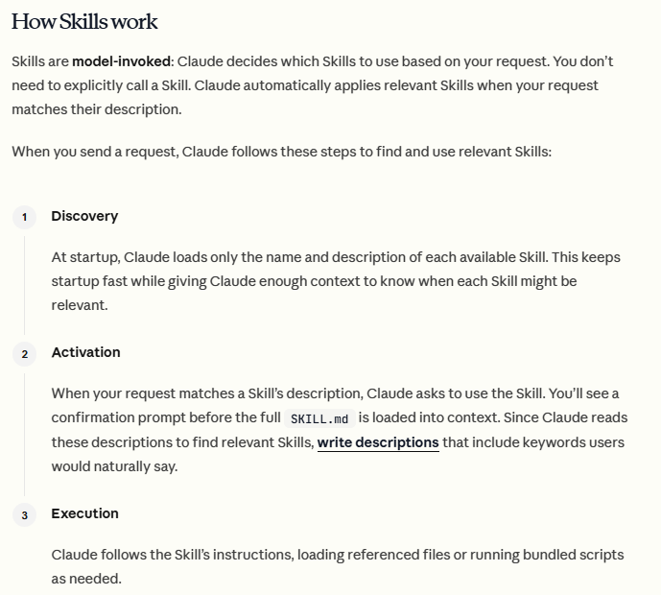
Implementation
Agent Skills
(Claude) Agent Skill
Reuse: Skill Anatomy & Concepts
Private Implementation
Progressive Disclosure Design Principle
Claude Agent Skill
Agent Skills
📁 skills/
├── 📁 skill_1/
├── 📁 skill_2/
├── 📁 skill_3
├── 📁 skill_3
└── 📁 ...
Skill Anatomy
📁 skill-name/
├── 🗎 SKILL.md
├── 📁 scripts/
├── 📁 references/
└── 📁 assets/
1. Determine which skill is needed
2. Load skill
3. Execute skill

Slide 9
Implementation
Project Structure
Agent Skills (github project)
📁 agent_skills/
├── 📁 agent
| ├── 📁 prompts
| | ├── 🗎 profile.md
| | ├── 🗎 goal.md
| | ├── 🗎 instructions.md
| ├── 🗎 run_agent.py
| ├── 🗎 skill_loader.py
└── 📁 skills
├── 📁 tsr
| ├── 🗎 SKILL.md
| | ├── YAML frontmatter metadata (required) (Triggering & routing - When to use)
| │ ├── name: (required)
│ │ └── description: (required)
| │ └── MD instructions (required) (Instructional control - workflow, heuristic)
| ├── 📁 scripts/ - Executable code (Executable implementation - Python/Bash)
| ├── 📁 references/ - Doc loaded into context as needed (Contextual knowledge)
| ├── 📁 assets/ - Files used in output (Output artifacts)
├── 📁 ...
Reuse OpenAI Agent
Reuse Claude Agent Skills

Slide 10
Implementation
TSR Skill
SKILL.md
scripts/ tsr_tools.py
---
name: tsr
description: Extract structured tables from table images and return them as HTML and/or OTSL using TSR or Perception VLM backends.
---
# TSR Skill
## Workflow
### 1) Extract table from an image
- Call: `tsr_extract(image_path, backend, output_format)`
- Backends:
- **tsr** – dedicated TSR model (best for structure accuracy)
- **perception** – general VLM (may return HTML directly)
### 2) Detect output format
- If result contains OTSL tags → treat as **OTSL**
- Otherwise → treat as **HTML**
### 3) Convert when needed
- OTSL → HTML using `otsl_to_html(otsl_text)`
### 4) Save result (optional)
- Save HTML file with `save_html(html, path)`
## Supported Outputs
- `html` – final structured table
- `otsl` – intermediate structured format
- `auto` – return both (recommended)
## Output Contract
- **tsr_extract** → raw text + detected format + OTSL/HTML
- **otsl_to_html** → HTML
- **save_html** → file path
## Prompting Rules
- Deterministic mode (`temperature=0`)
- High `max_tokens` for large tables
- Use TSR-focused prompts
## Debugging & Recovery
- Prefer **backend="tsr"** if quality is poor
- Increase max tokens if truncated
- Re-convert from OTSL when HTML is malformed
- Ensure input image is a proper table crop
## Notes
- Use tool calls for reliability
- Keep detailed prompts in reference files
# Exposed TSR Tools – Interfaces Only
def tsr_extract(
image_path: str,
backend: str = "tsr", # enum: ["tsr", "perception"]
output_format: str = "auto", # enum: ["auto", "otsl", "html"]
max_tokens: int = 8192,
prompt_text: str = "Extract table from this image."
) -> dict:
"""
Extract table structure from a table image via VLM backend.
Returns (JSON):
{
"raw_text": str, # raw model output
"detected_format": "otsl"|"html",
"otsl": str, # present if detected_format=otsl (or output_format allows)
"html": str, # present if detected_format=html OR converted from otsl (when possible)
"backend_used": "tsr"|"perception",
"model": str,
"base_url": str,
# optional:
"error": str
}
"""
pass
def otsl_to_html(otsl_text: str) -> dict:
"""
Convert OTSL -> HTML.
Returns (JSON):
{
"html": str,
# optional:
"error": str
}
"""
pass
def save_html(html: str, out_path: str) -> dict:
"""
Save HTML string to file.
Returns (JSON):
{
"out_path": str,
# optional:
"error": str
}
"""
pass
YAML frontmatter
Markdown

Slide 11
Implementation
How Does It Work: Overall flow (end-to-end flow)
User text
📁 agent_skills/
├── 📁 agent
| ├── 📁 prompts
| ├── 🗎 run_agent.py
| ├── 🗎 skill_loader.py
└── 📁 skills
├── 📁 tsr
├── 📁 ...
A. Loader/Adapter (load all skills)
Tools + Executors
B. Agent Loop
Final text response
A. Loader/Adapter: load_all_skills() → “turn Skill Folder into Tools + Executors”
Input: path to skills/
Output:
- tools: a list of tool schemas to be passed into client.responses.create(...)
- runtime["executors"]: a dictionary {tool_name: python_callable} used to actually execute the tools
Mechanism:
- Iterate through each folder inside skills/
- Skip folders that are not valid skills (hidden folders, or those without SKILL.md)
- Parse SKILL.md → extract name and description
- Enter the scripts/ directory and import each .py file
- In each script, call the convention function get_registered_tools() to obtain a list of tools:
{"name": ..., "description": ..., "parameters": ..., "fn": ...}
- Convert them into Responses API schema format:
{"type": "function", "name": ..., "description": ..., "parameters": ..., "strict": true}
- Store fn into executors for local execution
Result:
- The OpenAI model sees “tools” as a list of functions with schemas
- The runtime knows which Python function corresponds to each tool
B. Agent loop: run_agent.py → “model selects tool → runtime executes → returns result”
Input: user text
Output: final text response
Loop mechanism (per iteration):
1. Call the model:
resp = client.responses.create(model=..., tools=tools, input=input_list)
2. Append resp.output to input_list
- Purpose: to maintain “trace items” (especially for reasoning models) - Without this, the model may lose context in the next iteration 3. Filter items with type == "function_call" in resp.output 4. If there is no tool call → end the loop and print resp.output_text 5. For each function_call: - Extract name, arguments, call_id - Execute the actual Python function: executors[name](**args) - Append a function_call_output item to return the result to the model: {"type": "function_call_output", "call_id": ..., "output": "{...json...}"}
6. Return to step (1) with the updated input_list containing tool outputs
7. The model reads the tool outputs and synthesizes them into the final answer

Slide 12
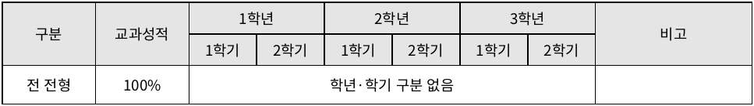
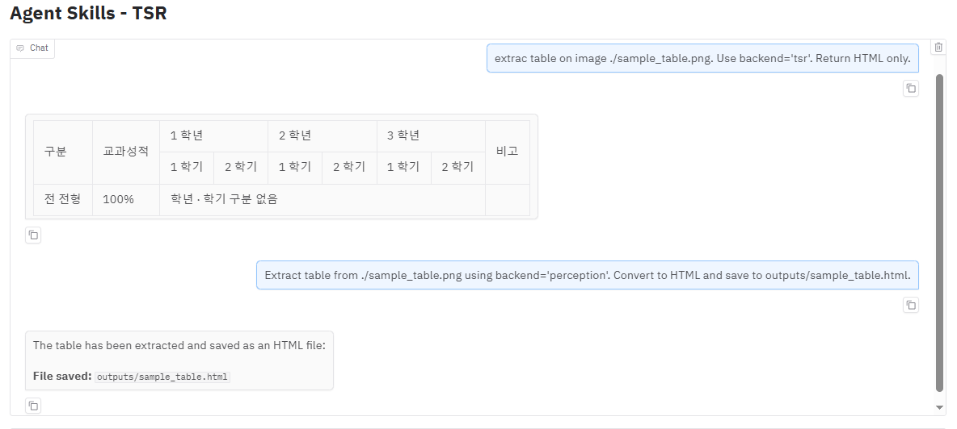
Demo
Github Project: Agent Skills
Gradio Demo: Agent Skills - TSR

Slide 13
Test & Results
Settings
Results
vLLM Serving | (OpenAI) oss-120b: LLM, Agent Brain (AgileSoDA) tsr-3b: VLM, TSR as tool (Finetuned VLM TSR lost Reasoning capability) (Nanonets) perception-3b: VLM, perception/ocr as tool
Skills | TSR Exposed Tools: tsr_extract otsl_to_html save_html
Agent | OpenAI Agent
Dataset | Trivia notnt (460 files) tnt (65 files)
Prompt | Extract table from $img_path using backend='$BACKEND'. Convert to HTML and save to $output_html.
Dataset | tsr-3b |  | perception-3b
 | TEDS (content) | TEDS-Struct | TEDS (content) | TEDS-Struct
BASE | ??? | ??? | NA | NA
notnt | 0.9377 | 0.9646 | 0.6291 | 0.6864
tnt | 0.9599 | 0.9710 | 0.4441 | 0.5038

Slide 14
Conclusion (1/2)
Agent Skills provide a practical and scalable agent architecture. → The goal is not a single TSR pipeline, but a general, extensible framework
TSR demonstrates the approach end-to-end → The Agent automatically selects Skills → Skills combine explicit workflows + executable tools → Autonomous, deterministic, and recoverable execution
Clear separation of Spec and Execution layers → Spec (Skills): domain/task expertise → Execution (Agent): tool calling and agent loop → Enables reuse of agent infrastructure

Slide 15
Conclusion (2/2)
Progressive Disclosure improves efficiency → Metadata → Instructions → References (on demand) → Lower cost, less noise, fewer hallucinations (in theorical)
Skills are folder-based and highly extensible → Easy to add new capabilities without changing the Agent core → Designed for multi-skill, real-world Document AI systems
Key takeaway → Agent Skills turn agents into modular, domain-expert systems.

Slide 16
Future Work
A. Expand Skill Library across Document AI tasks → Add skills for Table Detection (Subedi), Doc Classification (Jay), Field Extraction (Khan), Validation (James) → Intent: Validate scalability by composing multiple skills in a single agent
B. Advanced TSR Skill → Add more tools and improve skill → Intent: Detection → TSR → Validation → Post-processing
C. Towards Automatic Skill Creation → Explore semi-automatic generation of new Skills from task descriptions and examples → Intent: Agent creates Skill by Itself
D. Optimization → Direction 1: Skill Quality Evaluation → Direction 2: Memory-Enhanced Skills → Direction 3: Skill Optimization (SERO) → Intent: self-evolving, self-improvement

Slide 18
Claude Agent Skill
vLLM
Google AI Agent
OpenAI Agent
Agent Skills
Agent
vLLM
Orchestration (Agent Brain)
TSR
AI Models
oss-120b
Table Detection
tsr-3b
Doc Classification
Profile & Goal & Instruction
perception-3b
Field Extraction
…
…
Memory STM & LTM
Tools
OpenAI Client
Gemini Client
LLM Services
Planning
APIs
Functions
gpt
DB
Agents
gemini
…
Spec layer
Execution layer
Focus

Slide 19
📁 RedWhale_Agent_Skills/
├── 📁 agent
| ├── 📁 prompts
| | ├── 🗎 profile.md
| | ├── 🗎 goal.md
| | ├── 🗎 instructions.md
| ├── 🗎 run_agent.py
| ├── 🗎 skill_loader.py
└── 📁 skills
├── 📁 tsr
| ├── 🗎 SKILL.md
| | ├── YAML frontmatter metadata (required) (Triggering & routing - When to use)
| │ ├── name: (required)
│ │ └── description: (required)
| │ └── MD instructions (required) (Instructional control - workflow, heuristic)
| ├── 📁 scripts/ - Executable code (Executable implementation - Python/Bash)
| ├── 📁 references/ - Doc loaded into context as needed (Contextual knowledge)
| ├── 📁 assets/ - Files used in output (Output artifacts)
├── 📁 ...
Agent Skills
📁 skills/
├── 📁 skill_1/
├── 📁 skill_2/
├── 📁 skill_3/
├── 📁 skill_4/
└── 📁 ...
Skill Anatomy
📁 skill-name/
├── 🗎 SKILL.md
├── 📁 scripts/
├── 📁 references/
└── 📁 assets/

Slide 20
User text
📁 agent_skills/
├── 📁 agent
| ├── 📁 prompts
| ├── 🗎 run_agent.py
| ├── 🗎 skill_loader.py
└── 📁 skills
├── 📁 tsr
├── 📁 ...
A. Loader/Adapter (load all skills)
Tools + Executors
B. Agent Loop
Final text response
A. Loader/Adapter: load_all_skills() → “turn Skill Folder into Tools + Executors”
Input: path to skills/
Output:
- tools: a list of tool schemas to be passed into client.responses.create(...)
- runtime["executors"]: a dictionary {tool_name: python_callable} used to actually execute the tools
Mechanism:
- Iterate through each folder inside skills/
- Skip folders that are not valid skills (hidden folders, or those without SKILL.md)
- Parse SKILL.md → extract name and description
- Enter the scripts/ directory and import each .py file
- In each script, call the convention function get_registered_tools() to obtain a list of tools:
{"name": ..., "description": ..., "parameters": ..., "fn": ...}
- Convert them into Responses API schema format:
{"type": "function", "name": ..., "description": ..., "parameters": ..., "strict": true}
- Store fn into executors for local execution
Result:
- The OpenAI model sees “tools” as a list of functions with schemas
- The runtime knows which Python function corresponds to each tool
B. Agent loop: run_agent.py → “model selects tool → runtime executes → returns result”
Input: user text
Output: final text response
Loop mechanism (per iteration):
1. Call the model:
resp = client.responses.create(model=..., tools=tools, input=input_list)
2. Append resp.output to input_list
- Purpose: to maintain “trace items” (especially for reasoning models) - Without this, the model may lose context in the next iteration 3. Filter items with type == "function_call" in resp.output 4. If there is no tool call → end the loop and print resp.output_text 5. For each function_call: - Extract name, arguments, call_id - Execute the actual Python function: executors[name](**args) - Append a function_call_output item to return the result to the model: {"type": "function_call_output", "call_id": ..., "output": "{...json...}"}
6. Return to step (1) with the updated input_list containing tool outputs
7. The model reads the tool outputs and synthesizes them into the final answer

